Slide 1


SAVEETHA SCHOOL OF ENGINEERING
SAVEETHA INSTITUTION OF MEDICAL AND TECHNICAL SCIENCES
BUS RESERVATION SYSTEM
SUBMITTED BY GUIDED BY
K.L.V JAYARAM Dr. A. Jegatheesan
192210314 Professor
Department of CSE Department Of CSE
Saveetha School Of Engineering Saveetha School Of Engineering

Slide 2
CONTENTS
Abstract
Introduction
Software Requirements
Existing Work
Proposed Work
Use Case Diagram
Technology Used
Output
Conclusion
Future Enhancements
References

Slide 3
ABSTRACT
A Bus Reservation System is a digital platform designed to streamline the booking process for bus tickets. It provides users with an intuitive interface to search for available buses, select seats, and confirm bookings based on their preferred travel dates and destinations. This system not only enhances convenience by allowing bookings from anywhere at any time but also improves operational efficiency for bus operators by automating seat management and reservation handling.
Administrators benefit from tools to manage bus routes, schedules, and user accounts securely. Integrated features like payment gateways ensure secure transactions, while notifications keep users informed about booking statuses.
Overall, the Bus Reservation System aims to simplify travel planning, increase accessibility, and optimize resource utilization in the transportation industry.

Slide 4
INTRODUTION
A Bus Reservation System revolutionizes the way travelers plan and secure their journeys by leveraging digital technology to streamline the booking process for bus tickets. This system serves as a centralized platform where users can effortlessly search for available buses, select preferred seats, and make reservations according to their travel preferences and schedules. With intuitive user interfaces accessible via web or mobile applications, passengers can conveniently browse through routes, check seat availability in real-time, and complete bookings with ease.
From the perspective of bus operators and transportation companies, the Bus Reservation System plays a pivotal role in enhancing operational efficiency. It automates critical tasks such as seat management, scheduling, and passenger data management, thereby reducing manual errors and optimizing resource utilization. Administrators can efficiently oversee bus routes, monitor occupancy rates, and analyze booking trends to make informed decisions that improve service delivery and customer satisfaction.
By integrating secure payment gateways and providing seamless communication channels for notifications and updates, the system ensures a smooth and secure booking experience for travelers while driving business growth and operational effectiveness for bus operators.

Slide 5
Software requirements
Java Development Kit (JDK)
The JDK is essential for compiling and running Java programs. It provides the necessary tools, libraries, and runtime environment to execute the Currency Converter application. It's crucial to have the right version of JDK installed to ensure compatibility with the application's code and dependencies.
Java Swing Framework
Java Swing is a powerful GUI toolkit used to develop user-friendly interfaces. It provides a wide range of components like buttons, text fields, and drop-down lists, which are essential for creating the Currency Converter's graphical user interface.
Integrated Development Environment (IDE):
An IDE facilitates coding, debugging, and managing Java projects. It offers features like code completion, debugging tools, and project management capabilities.
Internet Connectivity
The Bus Reservation System relies on real-time booking tickets. This requires a stable internet connection to access the online API that provides the latest exchange data. Without internet connectivity, the application won't be able to function effectively, and users won't be able to perform conversions.

Slide 6
Existing work
The existing work on bus reservation systems spans various implementations and technologies aimed at improving booking efficiency and passenger convenience. Traditional systems relied on manual booking processes at physical counters, which have gradually evolved into sophisticated digital platforms
Modern bus reservation systems utilize web and mobile applications to allow passengers to browse schedules, select seats, and make payments online, thereby reducing queue times and enhancing accessibility.
Technological advancements have also facilitated real-time updates on bus availability, routes, and seat occupancy, enabling travelers to make informed decisions. Integration with GPS and mapping technologies enables tracking of buses in real-time, providing accurate arrival and departure information to passengers.
Additionally, these systems often incorporate features such as secure payment gateways, customer support interfaces, and loyalty programs to enhance user experience and encourage repeat bookings.

Slide 7
Proposed work
Enhanced User Experience: Introducing a more intuitive and responsive user interface that simplifies the booking process, enhances usability across different devices, and provides personalized recommendations based on user preferences and travel history.
Proper Billing and Payment Integration: Implementing a robust billing system that ensures accurate invoicing and transparent pricing for passengers. This includes automated billing processes that generate detailed invoices and receipts.
Ensuring billing transparency builds trust with passengers and facilitates seamless financial transactions, contributing to overall customer satisfaction and operational efficiency within the bus reservation system

Slide 8
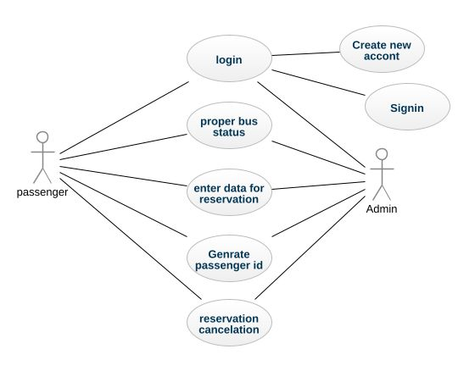
Use case diagram

Slide 9
Technology used
Library
Jcalender for the selection of date.
Java Swing Framework
Java Swing is a powerful and versatile graphical user interface (GUI) toolkit that provides a comprehensive set of components for building robust and visually appealing desktop applications.
Swing offers a wide array of widgets, including buttons, text fields, labels, scroll panes, and tables, allowing for the creation of interactive and user-friendly interfaces.
Its platform-independent nature ensures that applications built with Swing can run seamlessly across different operating systems without requiring code modifications.
Swing's flexibility and extensibility enable developers to customize and extend its functionality to meet specific application requirements.

Slide 10
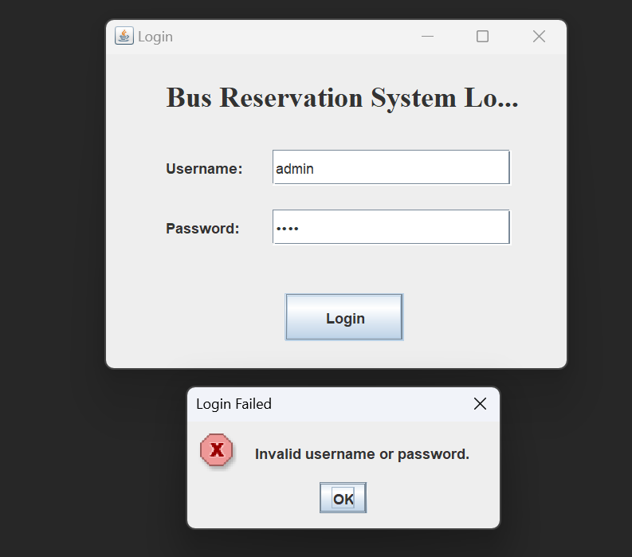
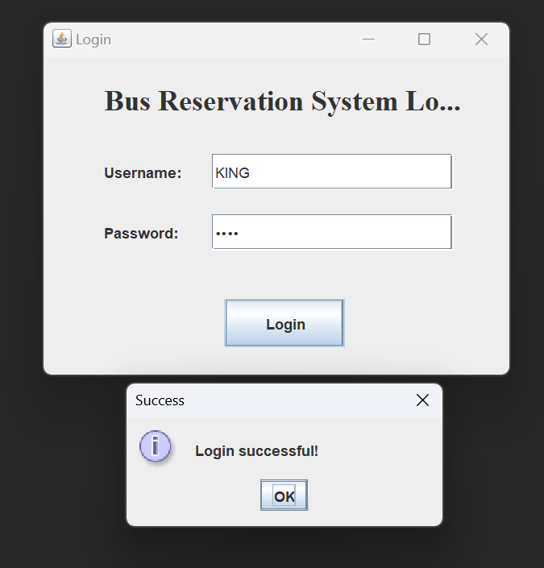
Output
Fig 1 & 2: The interface login screen with fields for entering the username and password, ensuring secure and personalized access. The username field allows users to input their unique identification, often assigned by the system administrator and deny for others.

Slide 11
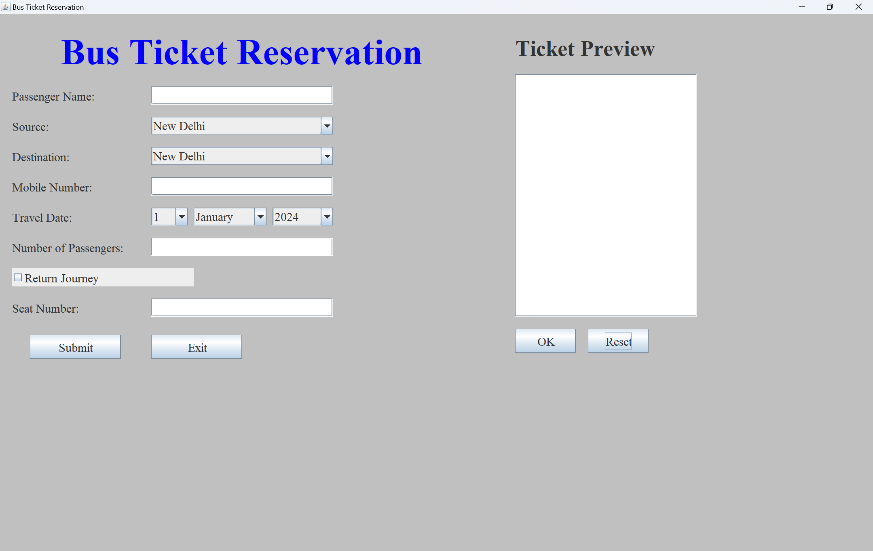

Slide 12
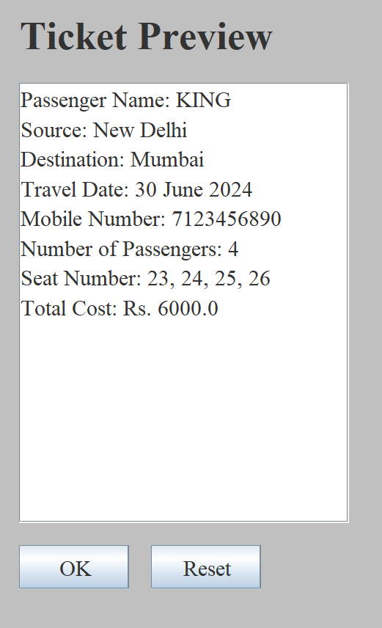
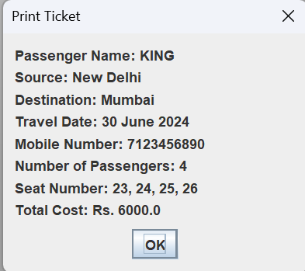
Fig4: Ticket Preview will be Generated.
Fig 5: Ticket Printed

Slide 13
Conclusion
The bus reservation system developed in Java Swing offers a robust solution for booking and managing bus tickets through a user-friendly graphical interface. It supports essential functionalities such as input validation for ensuring data integrity, cost calculation based on distance and passenger count, and a convenient ticket preview before final submission.
The system enhances user experience with error handling for invalid inputs and includes features like ticket printing upon confirmation. While the current implementation demonstrates core functionalities effectively, future iterations could explore enhancements such as database integration for persistent data storage and further refinement of the user interface to optimize usability and accessibility.

Slide 14
Future Enhancements
Database Integration: Implementing a database backend (like MySQL or SQLite) would enable the system to store booking details persistently. This would facilitate features such as booking history retrieval, analytics on popular routes, and better management of passenger data.
Advanced Authentication and Security: Enhance security measures by implementing more robust authentication methods, such as user roles and permissions management. This could include secure login protocols, encryption of sensitive data, and protection against common security threats like SQL injection.
Real-time Updates and Notifications: Incorporate real-time updates and notifications to inform users about booking confirmations, seat availability changes, and travel updates. This could be achieved through integration with messaging services or email notifications, enhancing communication between passengers and the reservation system.

Slide 15
References
A. R. Mohammed and S. S. Kassem, "UML Modeling of Online Public Bus Reservation System in Egypt," https://ieeexplore.ieee.org/document/9325604/metrics#metrics
M. Vlasakis, I. Keramidi, I. Moscholios, P. Sarigiannidis and M. Logothetis, "Call Admission Control under a Probabilistic Bandwidth Reservation Policy and Handover Queueing in Mobile Hotspots," https://ieeexplore.ieee.org/document/9907974
P. Wu, F. Chu, A. Che and Q. Shi, "A bus lane reservation problem in urban bus transit network," https://ieeexplore.ieee.org/document/6958149
Y. H. Choi, S. Seo, S. Kang and B. Lee, "Justification of Effective Reactive Power Reserves With Respect to a Particular Bus Using Linear Sensitivity," https://ieeexplore.ieee.org/document/5783533.
P. Wu, A. Che and F. Chu, "A bi-objective model for bus transit network and lane reservation integrated optimization," https://ieeexplore.ieee.org/document/8948119
S. Zhang, X. Zhang and P. Wu, "Optimal dynamic bus lane reservation via bi-level programming," https://ieeexplore.ieee.org/document/10004089

Slide 16
THANK YOU
Notes:
THANK YOU

